Slide 1
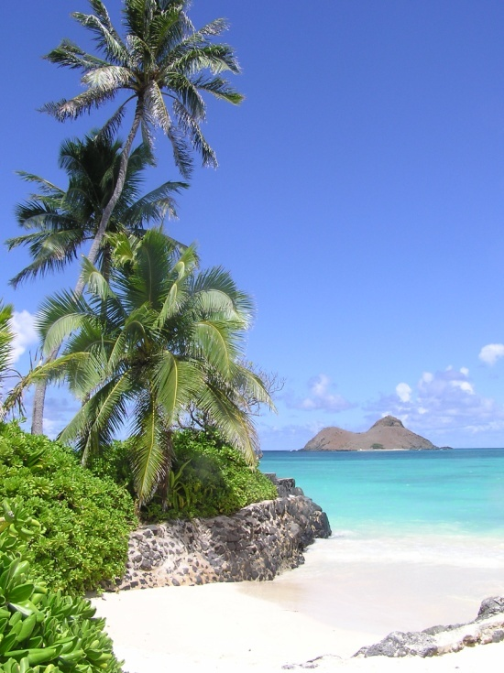
Reach out Pacific (REPAC)

Slide 2
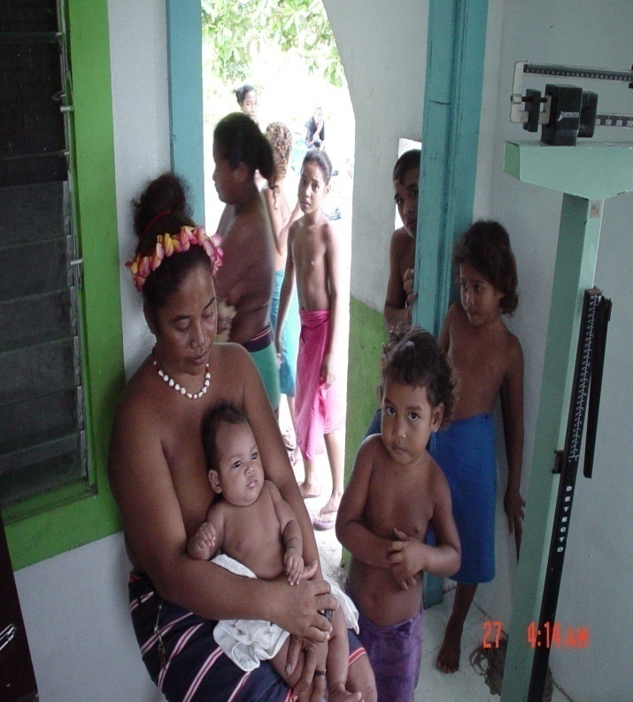
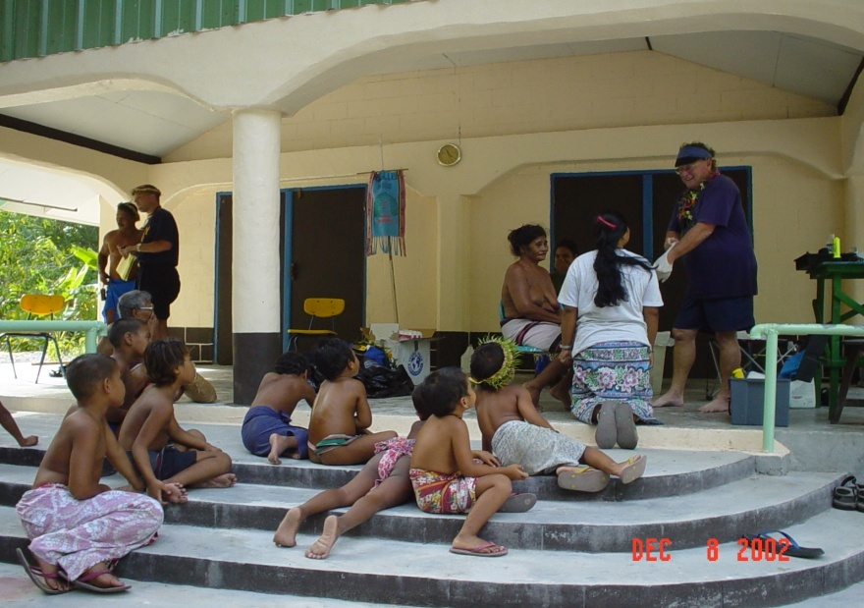
REPAC: Mission
Improve healthcare and education in Micronesia
Collect /distribute surplus supplies from public and private institutions in Hawaii
Interface with APIL

Slide 3
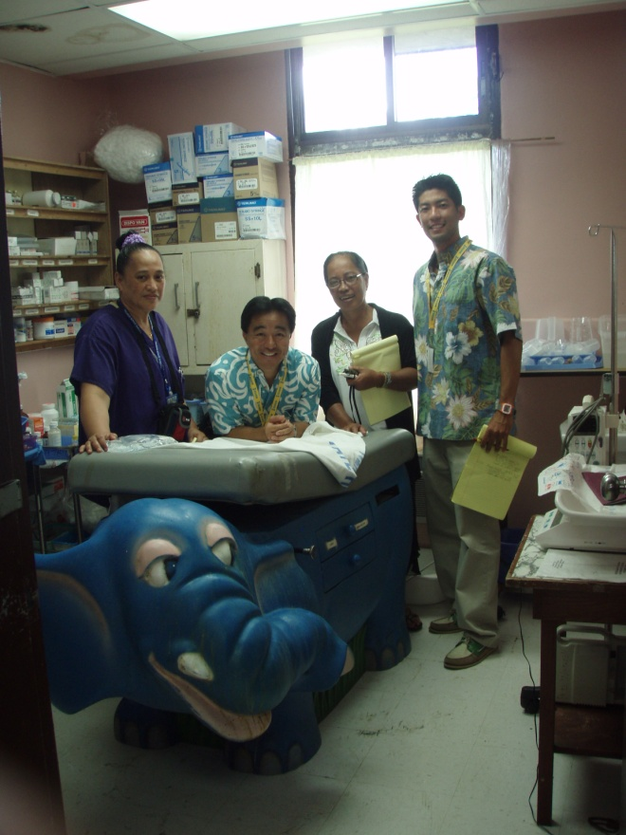
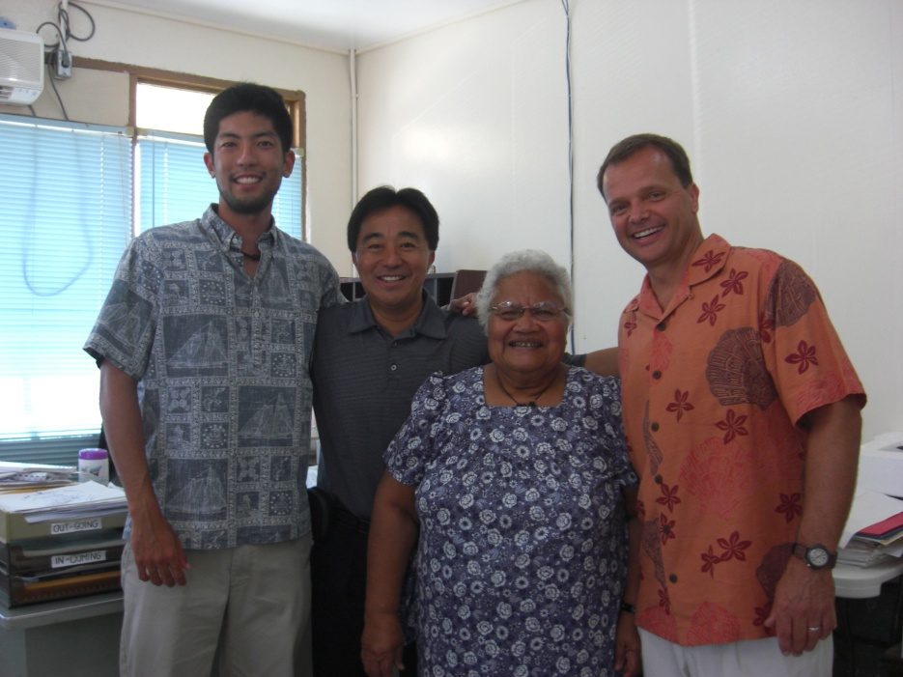
REPAC Board Site Visits
June 09: Pohnpei, Yap, Palau
Assess Needs
Health and Education Ministers
Doctors/Nurses
Teachers and Principals
Identify Partners
Responsiveness
Internet Access (Website)
Evaluation Component

Slide 4
Pohnpei Library
Not enough shelves to accommodate books. Many are being stocked in the office.
Reference section contains dictionaries and encyclopedias from 1990-1991.

Slide 5
Palau, CNMI, Pohnpei, July 2009 UH Bookshelves/Educational Supplies
3 Containers of bookshelves
6 Study carrels
6 TVs and carts
4 card catalogs
120 boxes of library books

Slide 6
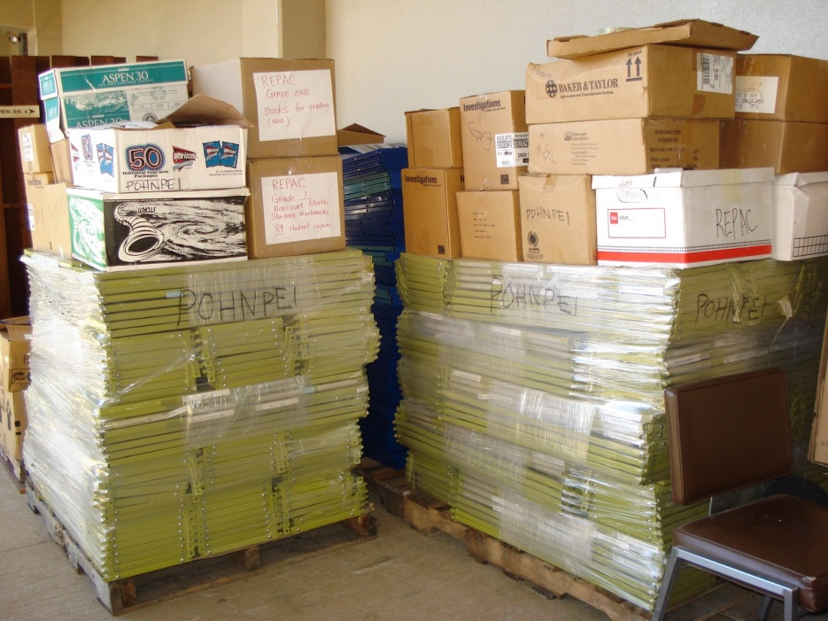
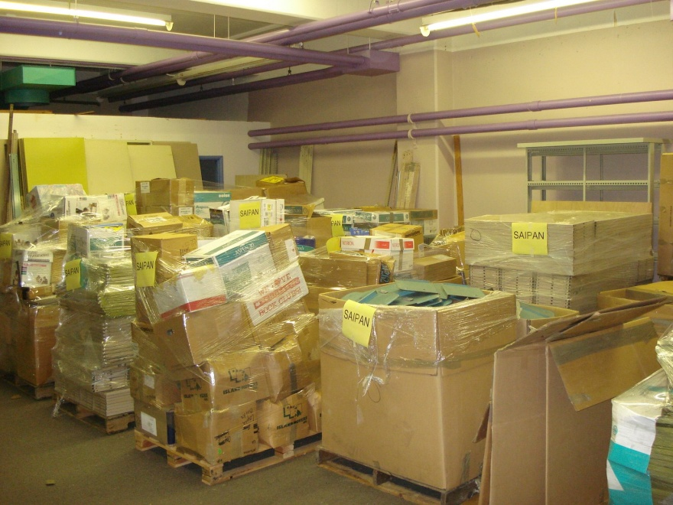
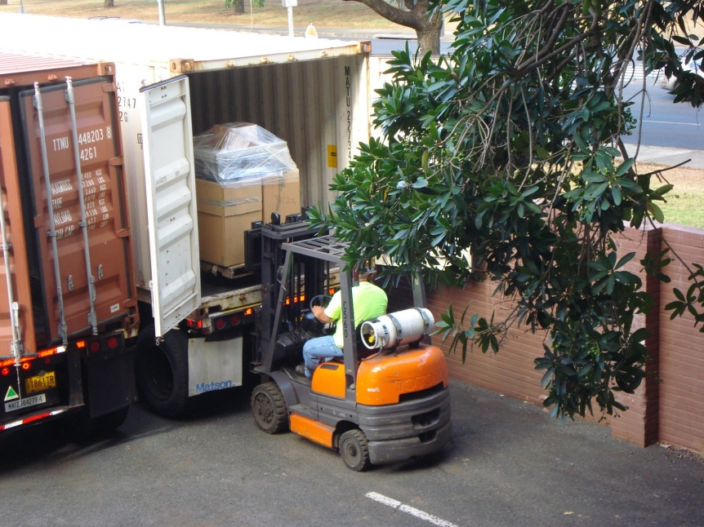
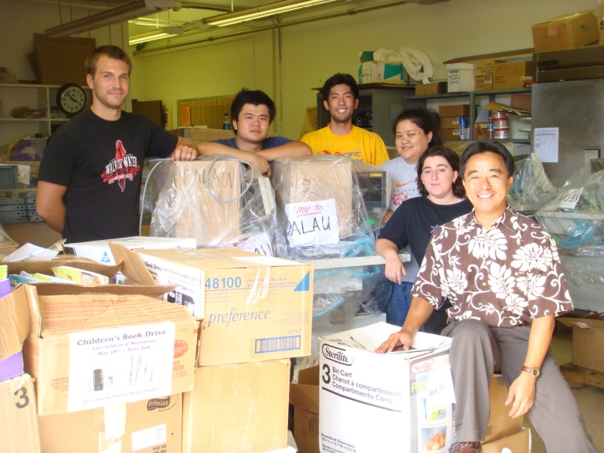
Moving Day, July 09

Slide 7
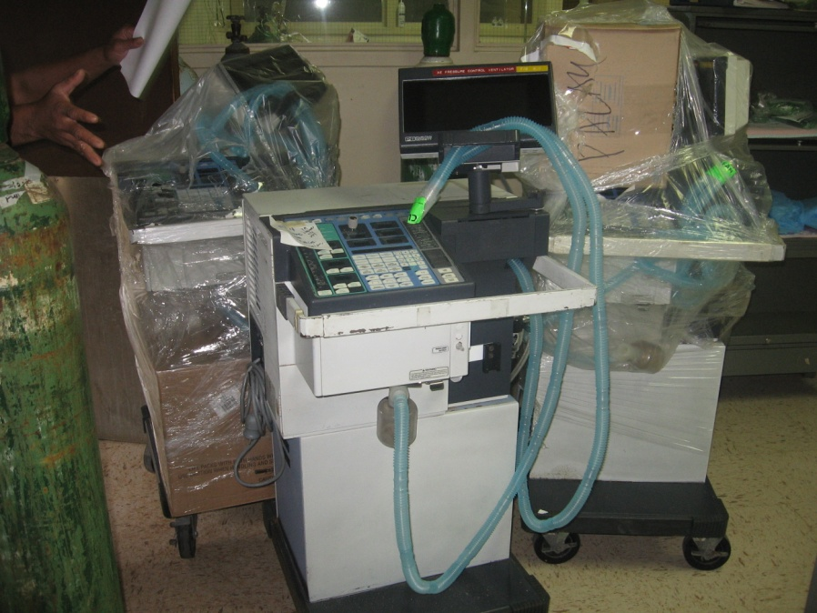
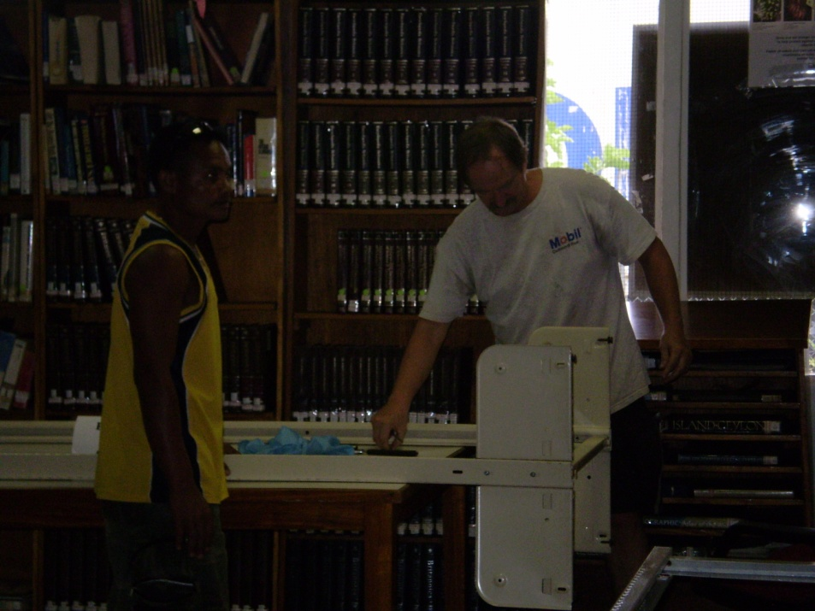
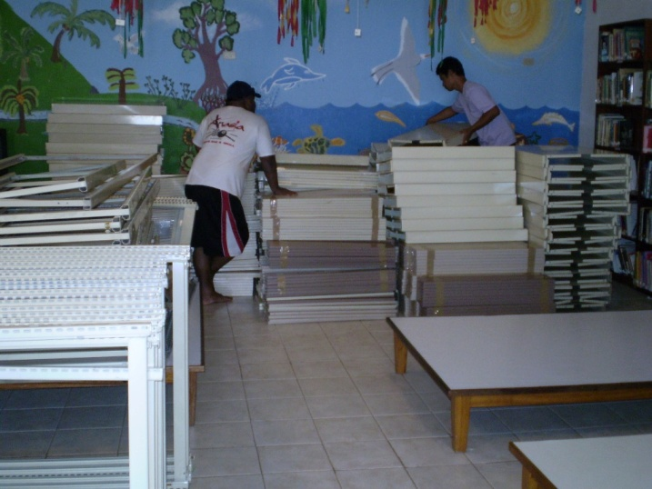
Arrival in Pohnpei
3 ventilators to Pohnpei Hospital
Rotary Club assembles shelves at Pohnpei Library

Slide 8
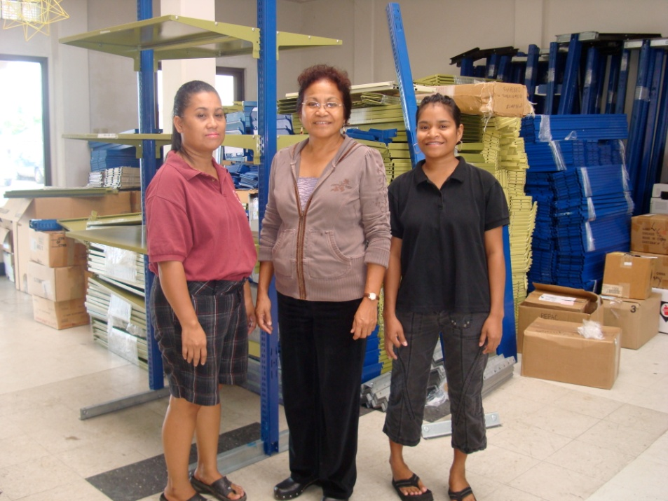
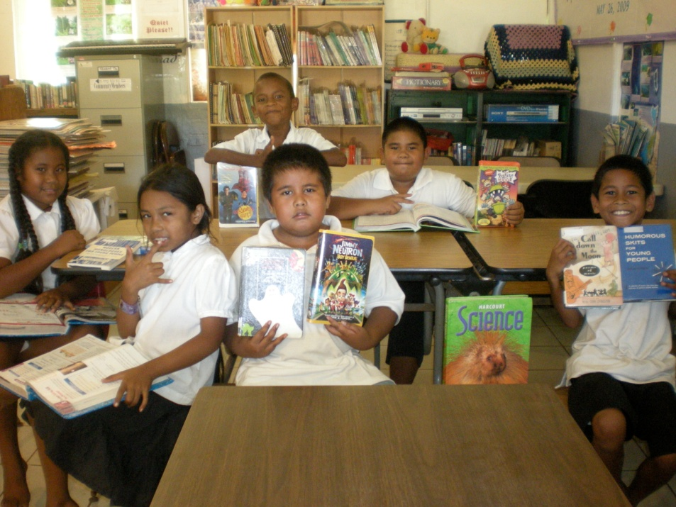
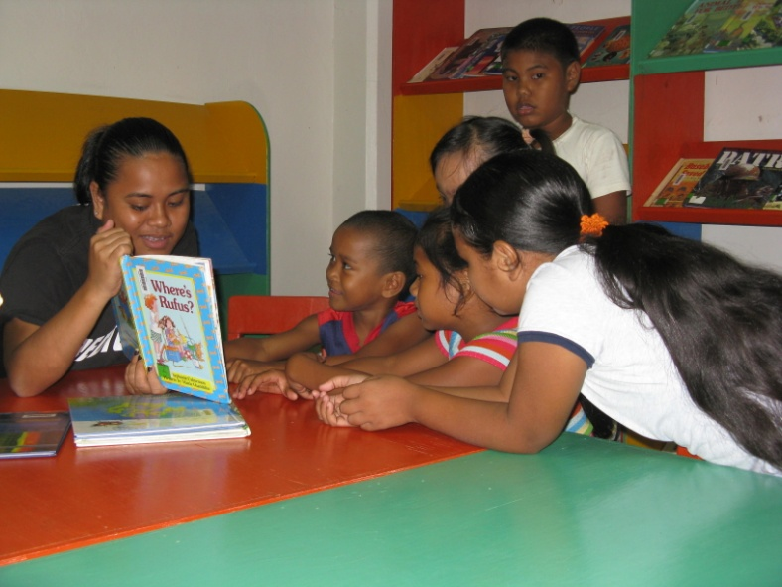
Arrival in Palau
Shelves to Palau Museum and Library
Books to Peleliu and Ngarchelong Elementary School

Slide 9
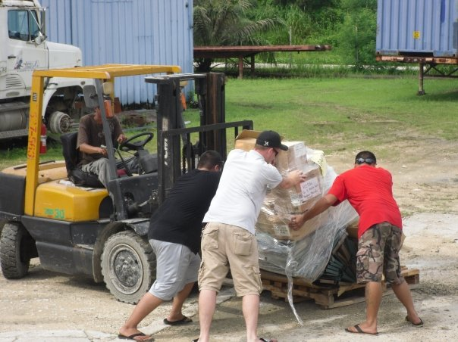
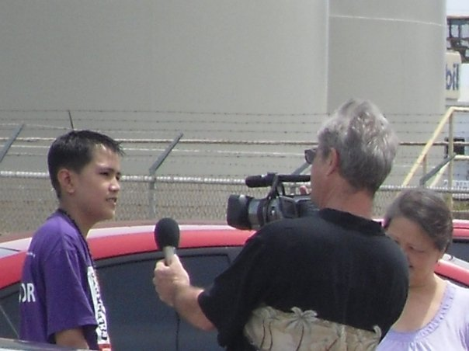
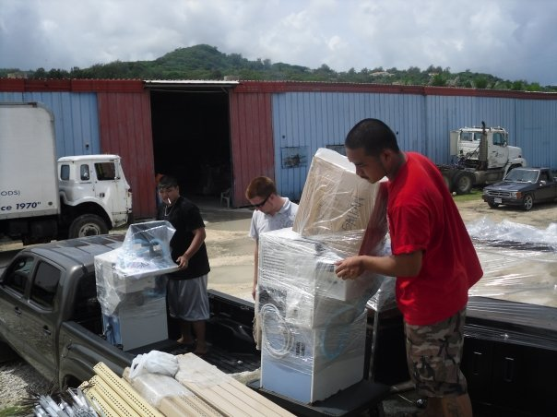
Arrival in Saipan
Books and shelves to Public Schools and library
3 ventilators and toys to CHC

Slide 10
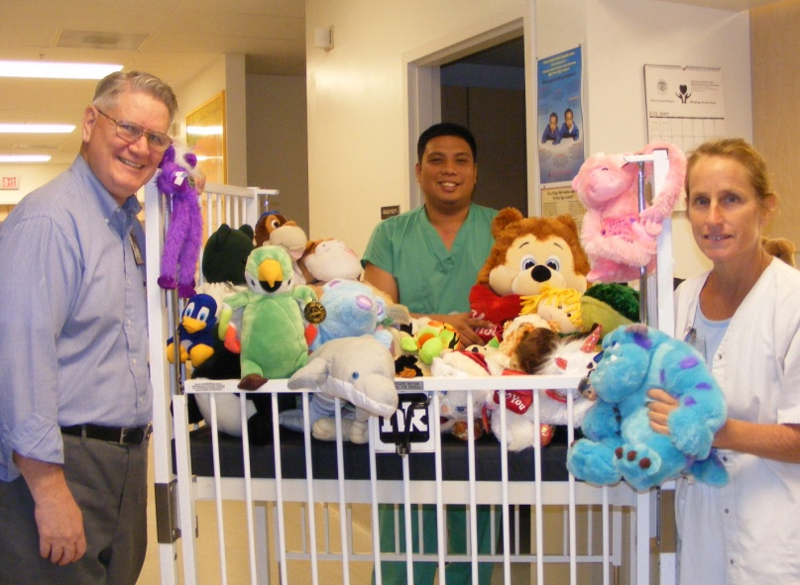
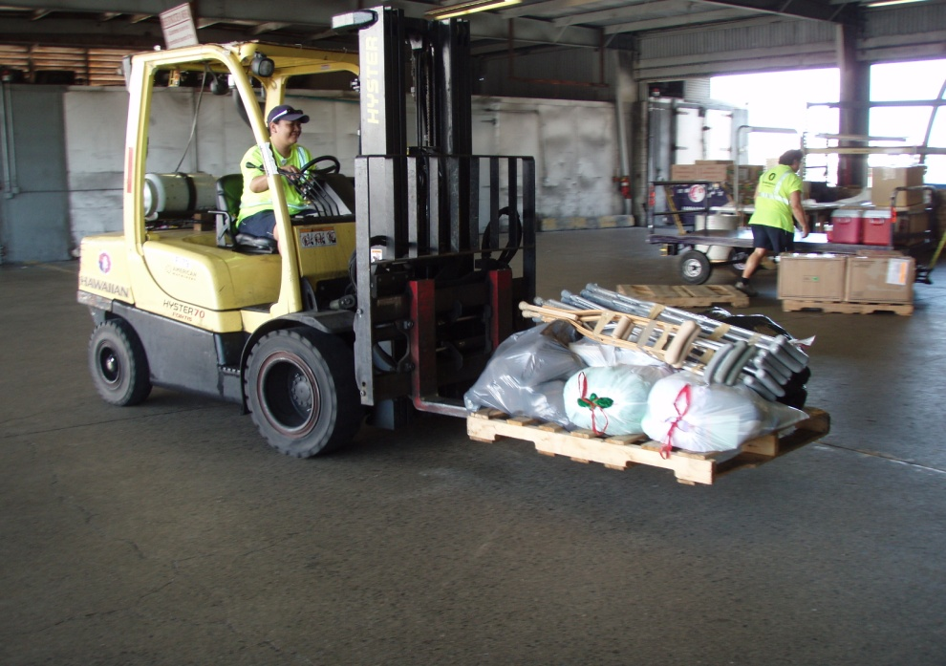
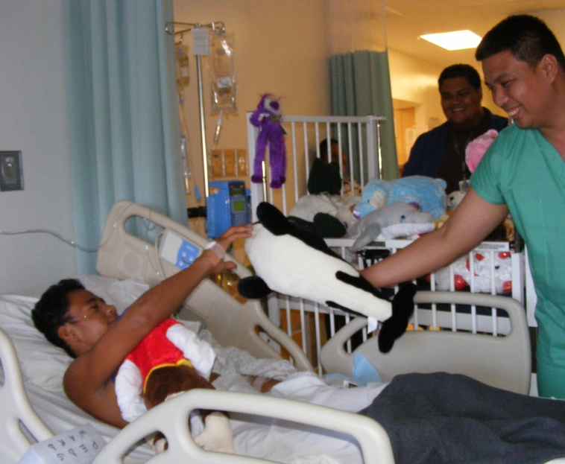
American Samoa, July 09
40 Nebulizers
8 boxes of stuffed animals
2 sets of crutches

Slide 11
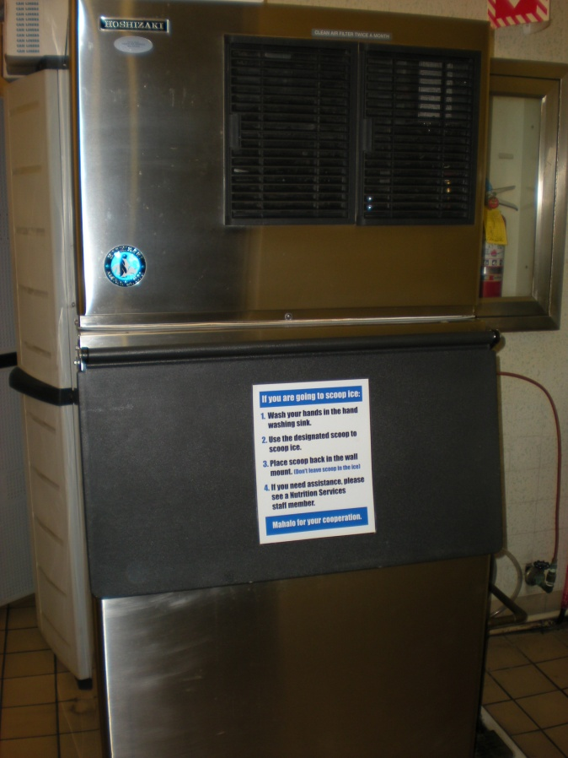
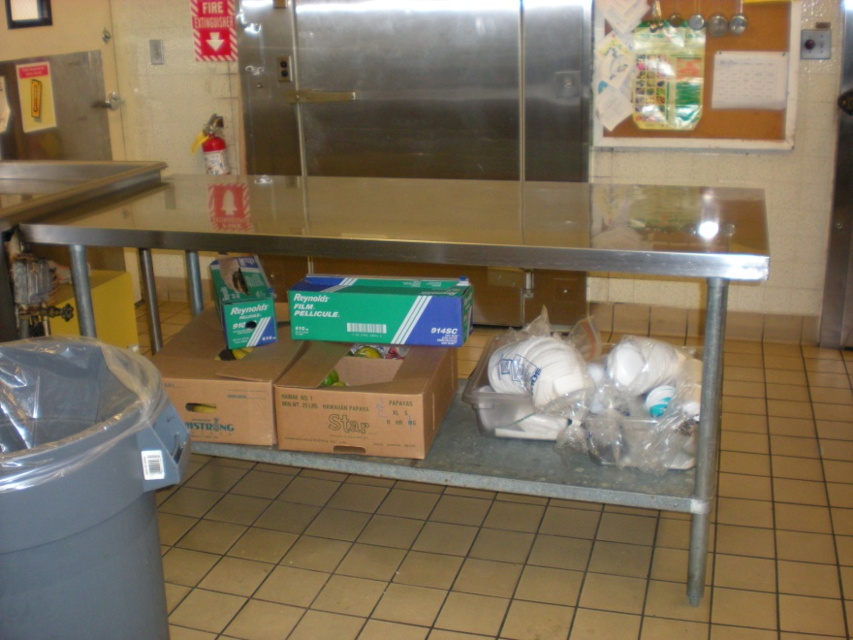
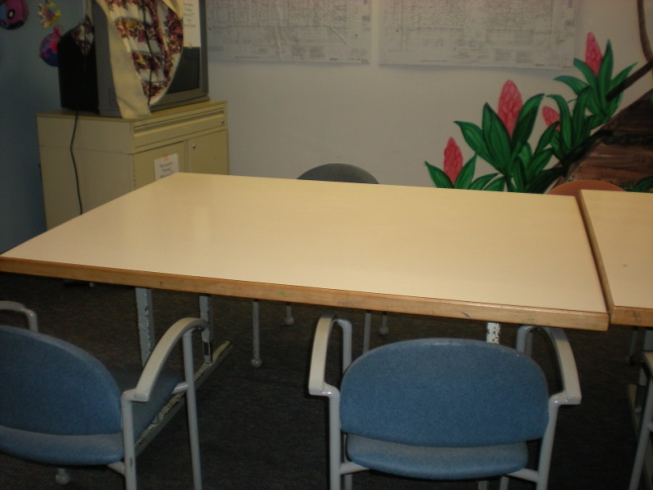
Shriners Demolition
Tore down building in Sept. 09

Slide 12
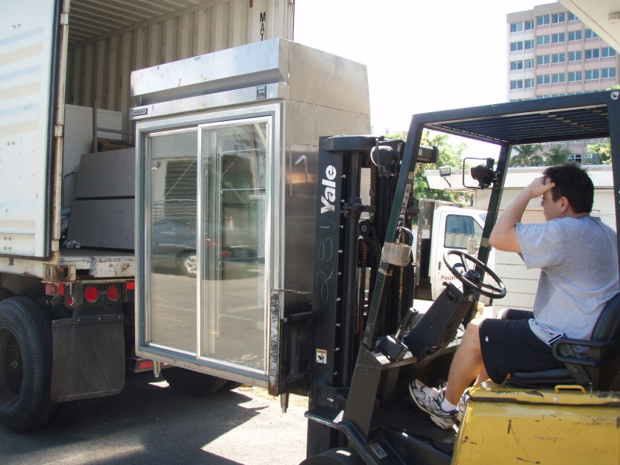
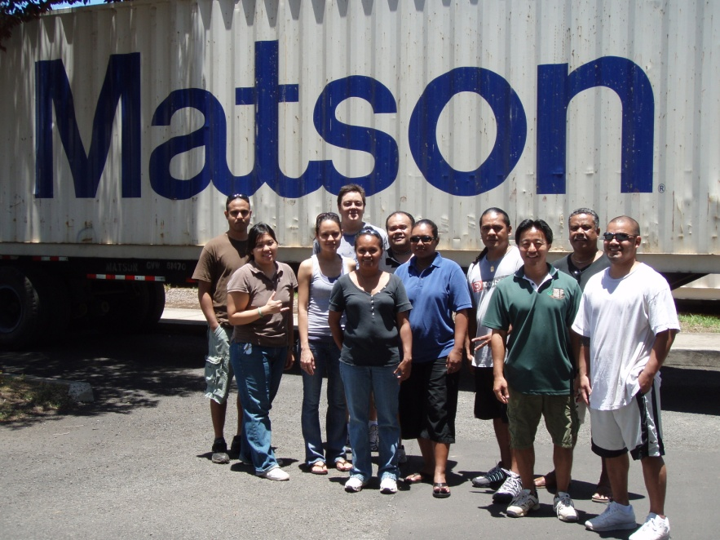
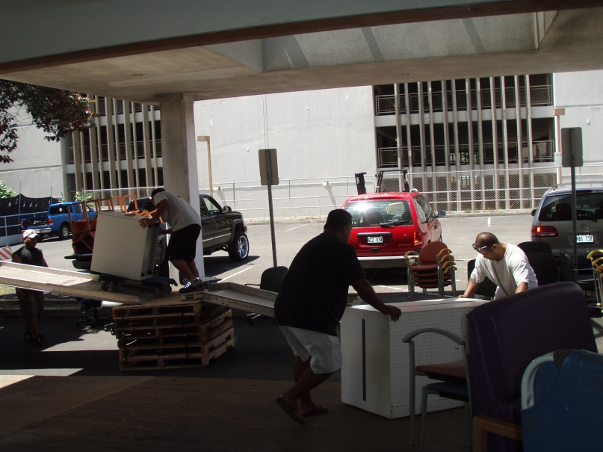
Palau and Pohnpei, August 09
Two 40-foot containers
Medical and industrial kitchen equipment, office furniture

Slide 13
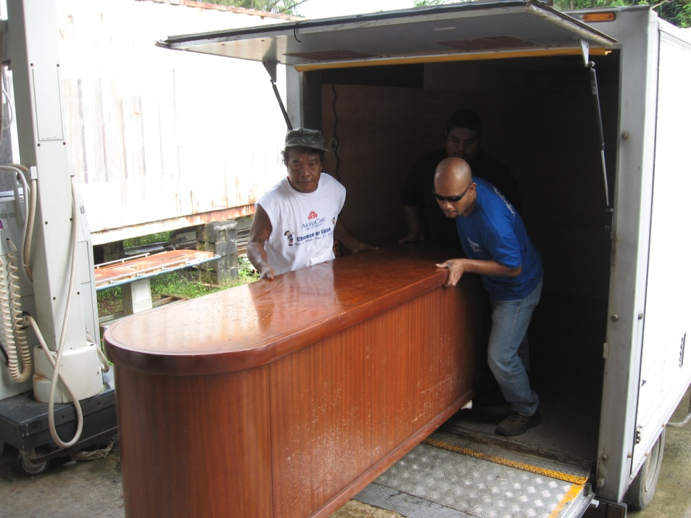
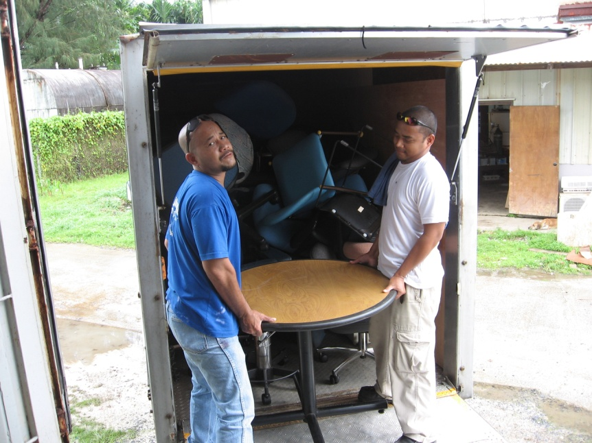
Arrival in Pohnpei
Assortment of office supplies for the Pohnpei Hospital

Slide 14
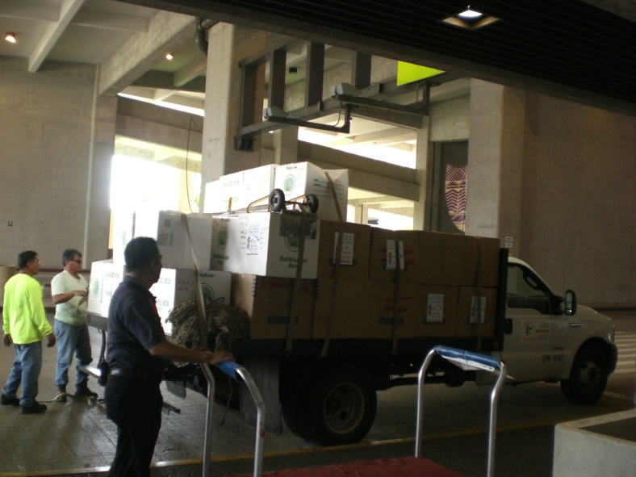
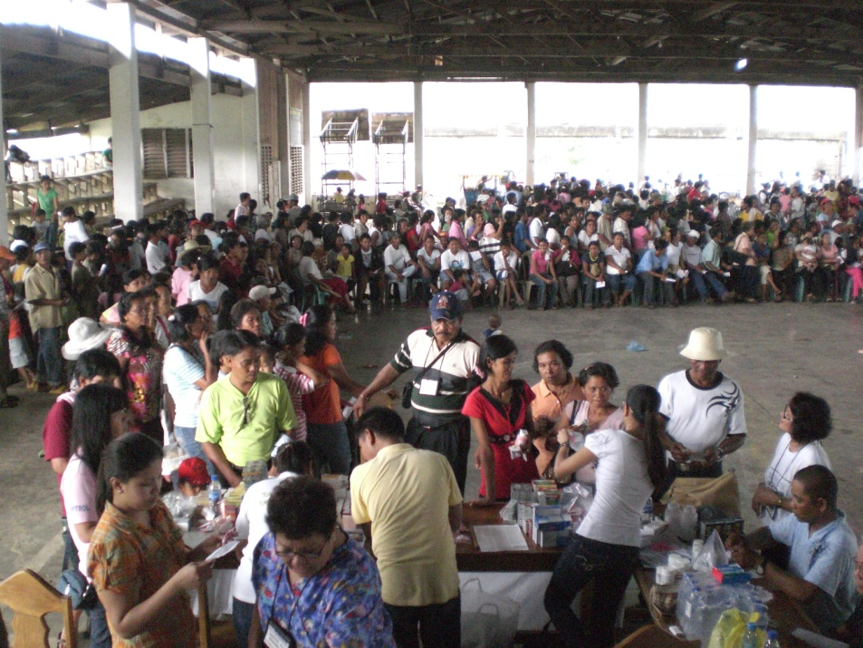
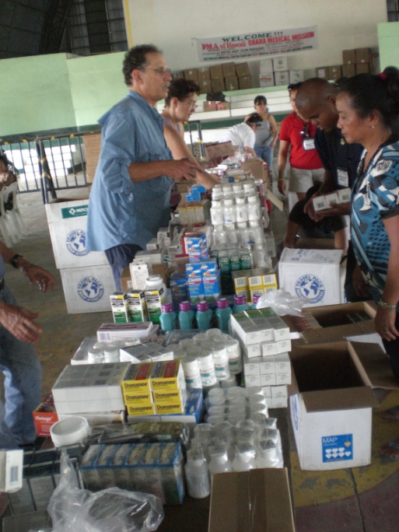
Manila, September 09
Philippine Medical Mission to Laoag, RP
50 boxes of pharmaceutical items

Slide 15
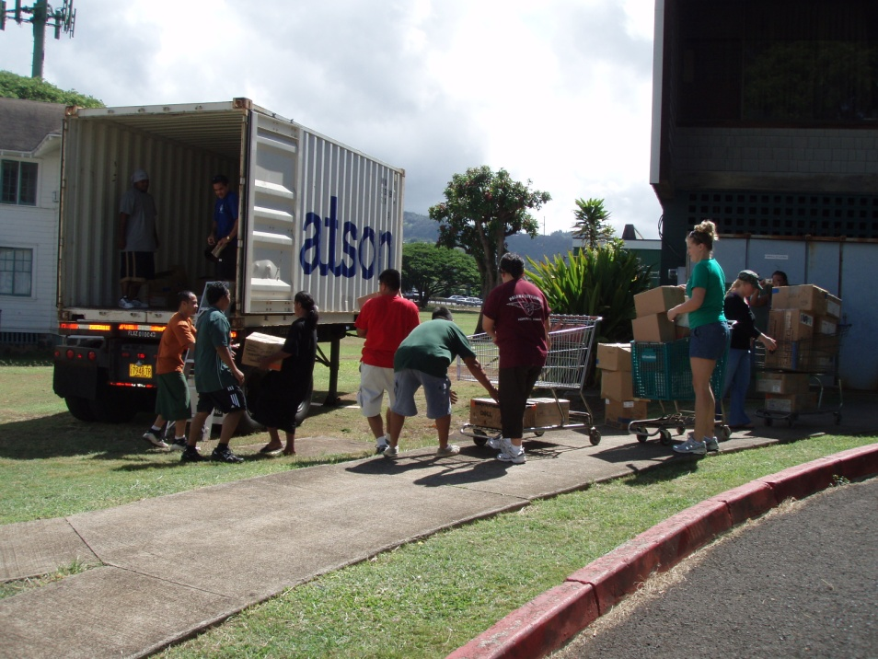
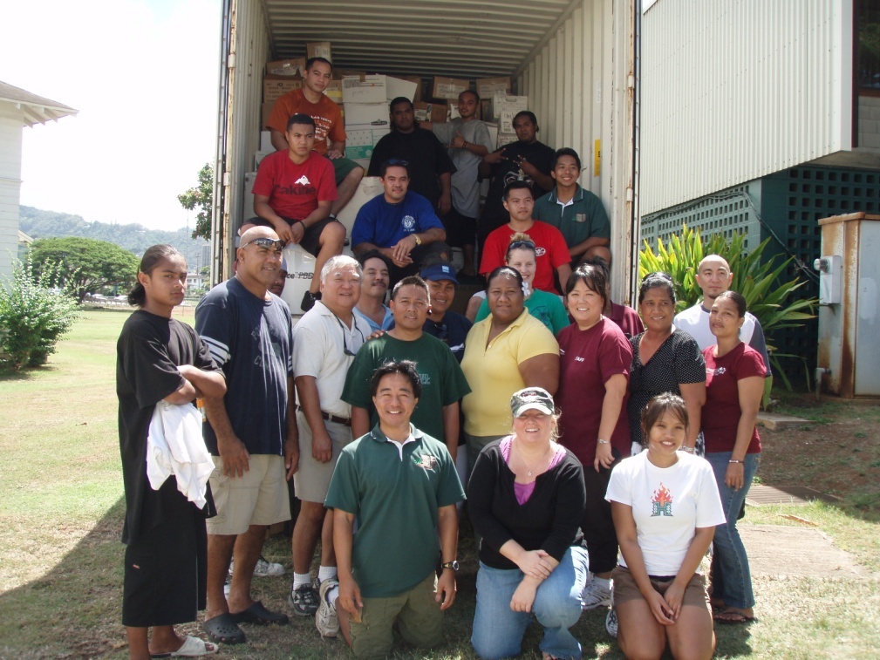
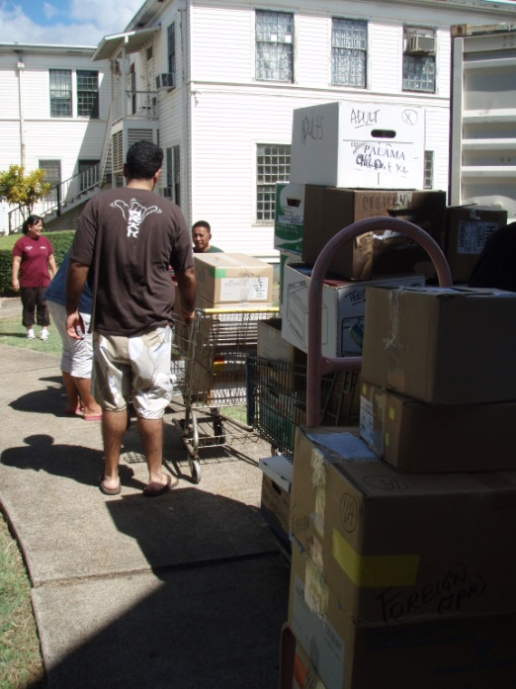
Pohnpei, September 09
20-foot container filled with library books filing cabinets, and linens
Palama Settlement

Slide 16
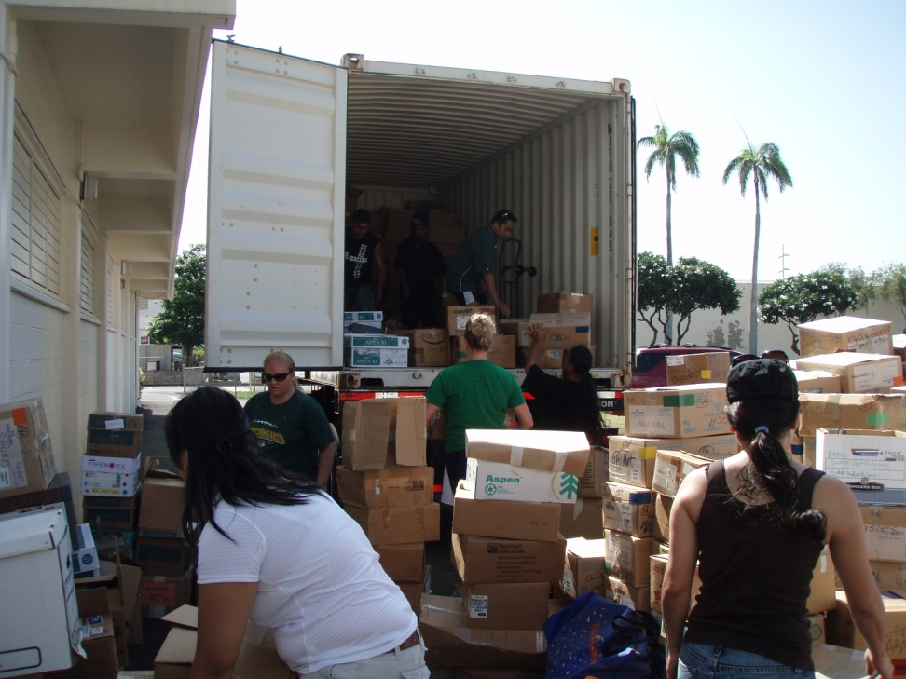
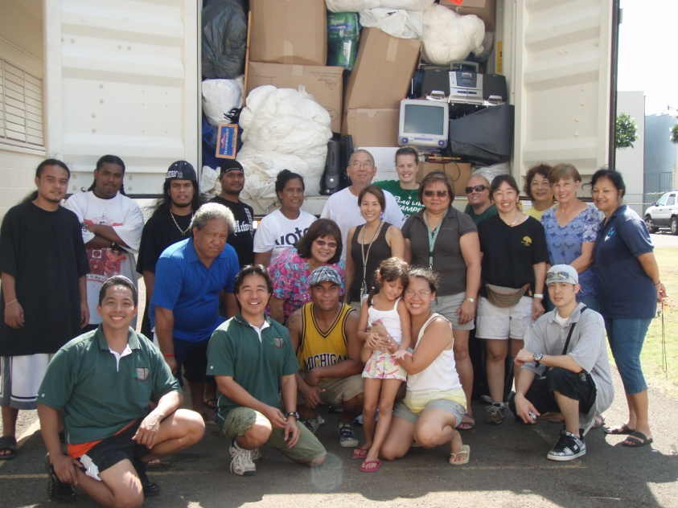
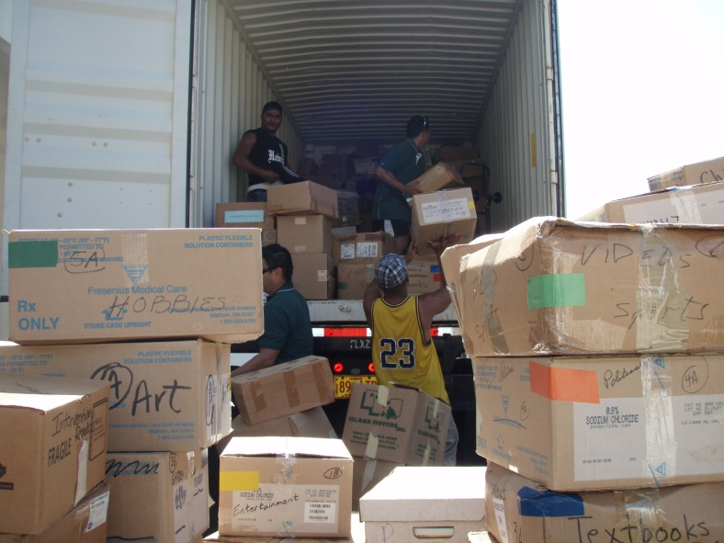
Chuuk, Oct.’09 (Make Difference Day)
20-foot container filled with books, linens and computers.
Kaiulani Elementary.

Slide 17
REPAC Projects
Previous Total $261,000
Past six months:
American Samoa $2,000
Palau / Pohnpei/CNMI, $180,000
Palau / Pohnpei $160,000
Laoag, Philippines $8,000
Chuuk $25,000
VALUE OF PROJECTS $636,000

Slide 18
Kiribati, January 2010
Partnership with Holland America Cruise Lines
Supplies to Fanning Island

Slide 19
MOA with HAH and AMM
Tap resources and storage space at the Healthcare Assoc. of Hawaii
5,000 sq ft warehouse
Disaster preparedness (Set up a 50 bed hospital in 24 hours)

Slide 20
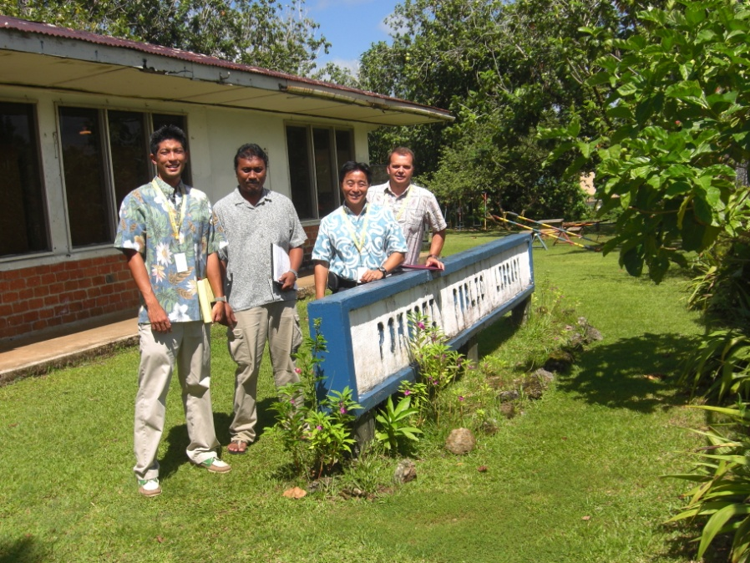
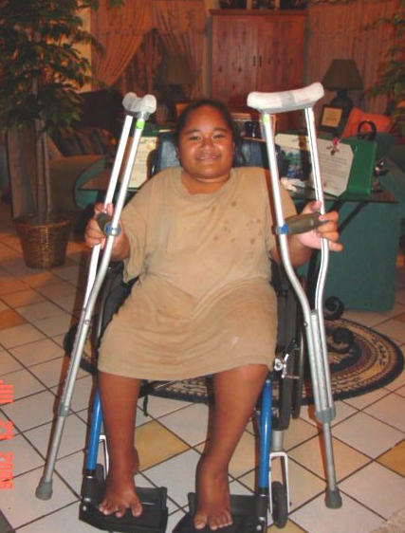
Thank you
reachoutpacific@gmail.com
www.ReachoutPacific.org
Now Live!

